Slide 1
HW5 Support Material

Slide 2
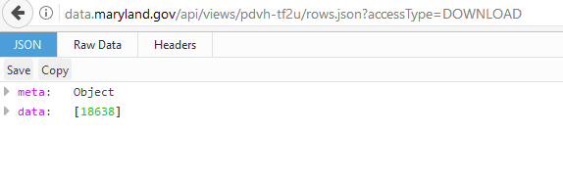

Slide 3
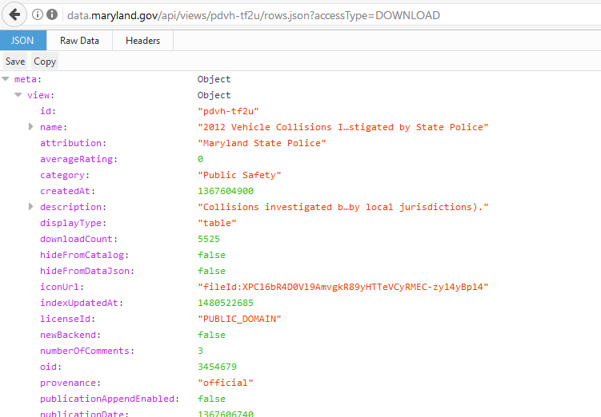

Slide 4
{ "meta" : { "view" : { "id" : "pdvh-tf2u", "name" : "2012 Vehicle Collisions Investigated by State Police", "attribution" : "Maryland State Police", "averageRating" : 0, "category" : "Public Safety", "createdAt" : 1367604900, "description" : "Collisions investigated by the Maryland State Police in 2012 (does not include collisions investigated by local jurisdictions).", "displayType" : "table", "downloadCount" : 3938, "hideFromCatalog" : false, "hideFromDataJson" : false, "iconUrl" : "fileId:XPC16bR4D0Vl9AmvgkR89yHTTeVCyRMEC-zy14yBp14", "indexUpdatedAt" : 1480522685, "licenseId" : "PUBLIC_DOMAIN

Slide 5
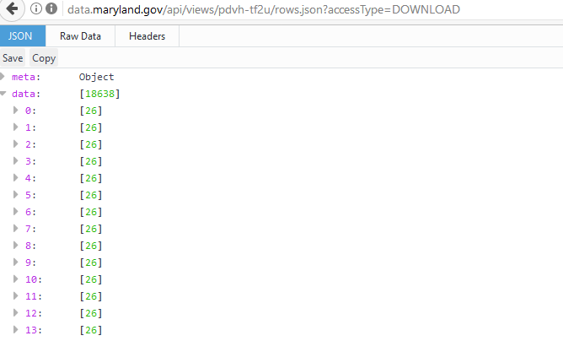

Slide 6
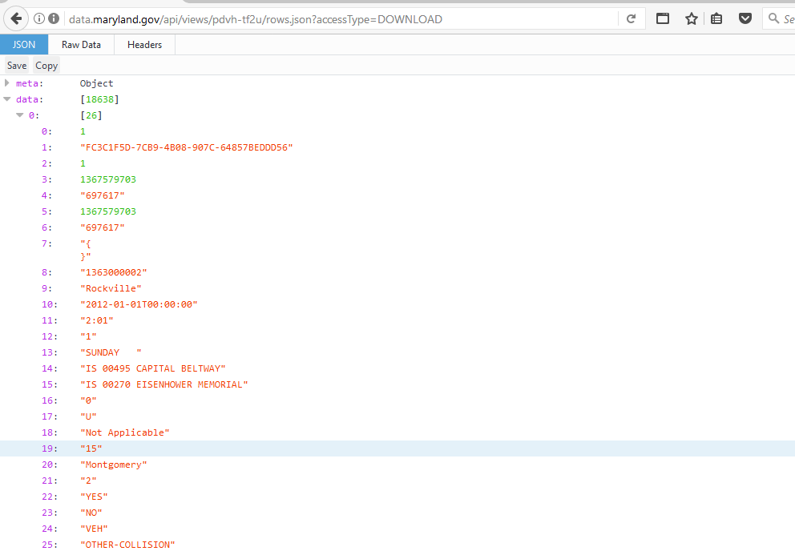

Slide 7
"data" : [ [ 1, "FC3C1F5D-7CB9-4B08-907C-64857BEDDD56", 1, 1367579703, "697617", 1367579703, "697617", "{\n}", "1363000002", "Rockville", "2012-01-01T00:00:00", "2:01", "1", "SUNDAY ", "IS 00495 CAPITAL BELTWAY", "IS 00270 EISENHOWER MEMORIAL", "0", "U", "Not Applicable", "15", "Montgomery", "2", "YES", "NO", "VEH", "OTHER-COLLISION" ] , [ 2, "D16F0B23-8EBD-4A2A-8333-B090A1F4073E", 2, 1367579703, "697617", 1367579703, "697617", "{\n}", "1296000023", "Berlin", "2012-01-01T00:00:00", "18:01", "5", "SUNDAY ", "MD 00090 OCEAN CITY EXPWY", "CO 00220 ST MARTINS NECK RD", "0.25", "W", "Not Applicable", "23", "Worcester", "1", "YES", "NO", "FIXED OBJ", "OTHER-COLLISION" ] , [ 3, "6A8ED8B0-D91F-44C9-ACE1-612A59A0B99B", 3, 1367579703, "697617", 1367579703, "697617", "{\n}", "1283000016", "Prince Frederick", "2012-01-01T00:00:00", "7:01", "2", "SUNDAY ", "MD 00765 MAIN ST", "CO 00208 DUKE ST", "100", "S", "Not Applicable", "4", "Calvert", "1", "YES", "NO", "FIXED OBJ", "FIXED OBJ" ] , [ 4, "55B44317-F0C6-4923-AEC1-4DD6B6CB340B", 4, 1367579703, "697617", 1367579703, "697617", "{\n}", "1282000006", "Leonardtown", "2012-01-01T00:00:00", "0:01", "1", "SUNDAY ", "MD 00944 MERVELL DEAN RD", "MD 00235 THREE NOTCH RD", "10", "E", "Not Applicable", "18", "St. Marys", "1", "YES", "NO", "FIXED OBJ", "OTHER-COLLISION" ] , [ 5, "51E0CDF3-4CA8-4F5B-927B-AA37A94DFEFF", 5, 1367579703, "697617", 1367579703, "697617", "{\n}", "1267000007", "Essex", "2012-01-01T00:00:00", "1:01", "1", "SUNDAY ", "IS 00695 BALTO BELTWAY", "IS 00083 HARRISBURG EXPWY", "100", "S", "Not Applicable", "3", "Baltimore", "2", "YES", "NO", "VEH", "OTHER-COLLISION" ] , [ 6, "B4D3E2BE-73C9-41A6

Slide 8
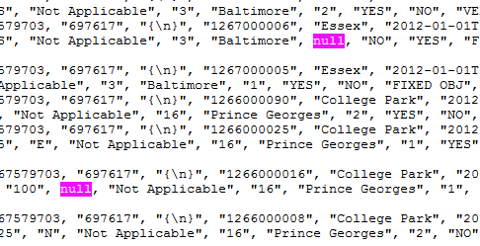

Slide 9

After you read "https://data.maryland.gov/api/views/pdvh-tf2u/rows.json?accessType=DOWNLOAD"
You need to isolate data for cleansing, transformation, inquiry (sqldf, tapply)

Slide 10
Consider some cleansing -→ NULLS
# count how many elements are in "myList" and store the number into variable "numRows“
numRows <- length(myList)
# Test every elements in "myList" one by one, for each element:
# First, record the element into a temporary variable "record",
# Second, if the original element is NULL, assign NA to "record". If not, keep the original value.
# Third, re-assign the value of "record" to the element in "myList"
for(i in 1:numRows) {
record <- myList[[i]]
record[sapply(record, is.null)] <- NA
myList[[i]] <- record
}

Slide 11
Other
Transform list to a df
Are there any NA’s, how do you check
sqldf
tapply
Spaces in fields (ie “white space”) , how will you manage

Slide 12
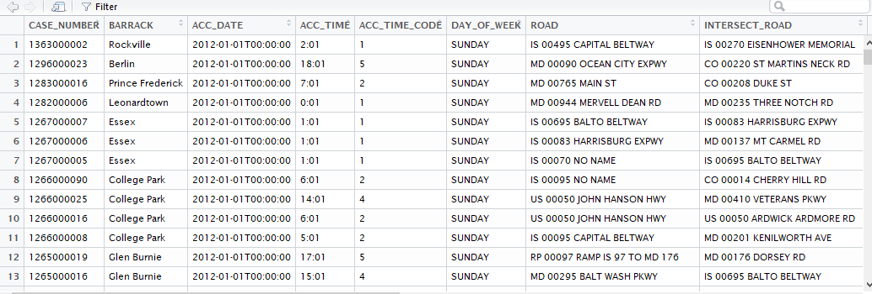
Cleansed/transformed data frame,,,, ready for sqldf & tapply

